Slide 1
“Treasures both new and old”
Inventing old age in the Catholic Tradition
Dr Peter Kevern
Professor of Values in Health & Social Care

Slide 2
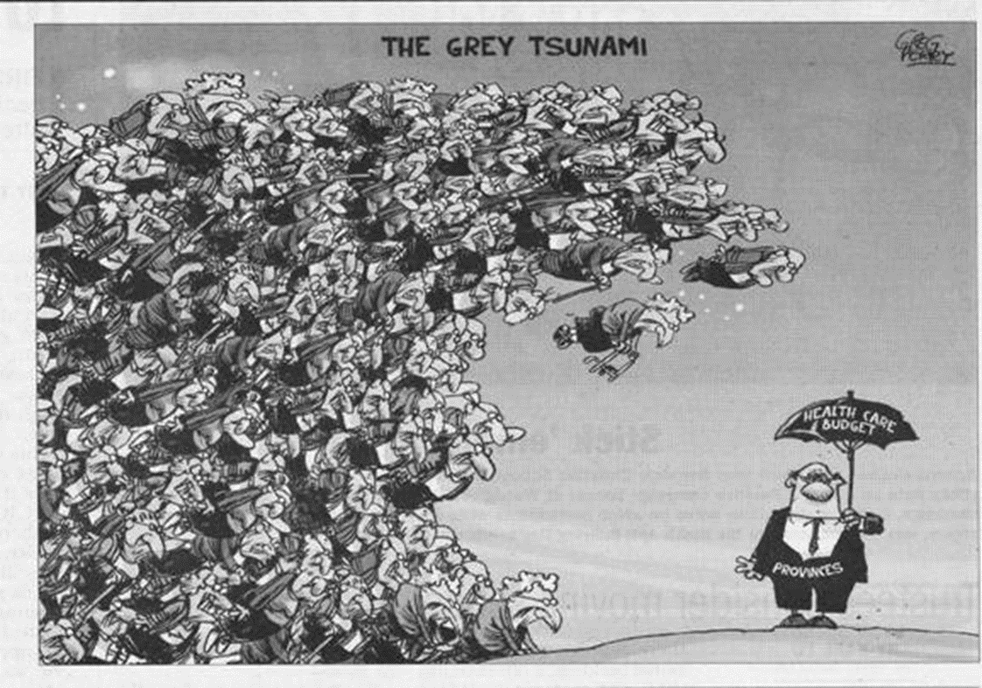
The ‘grey tsunami’ of our fear

Slide 3
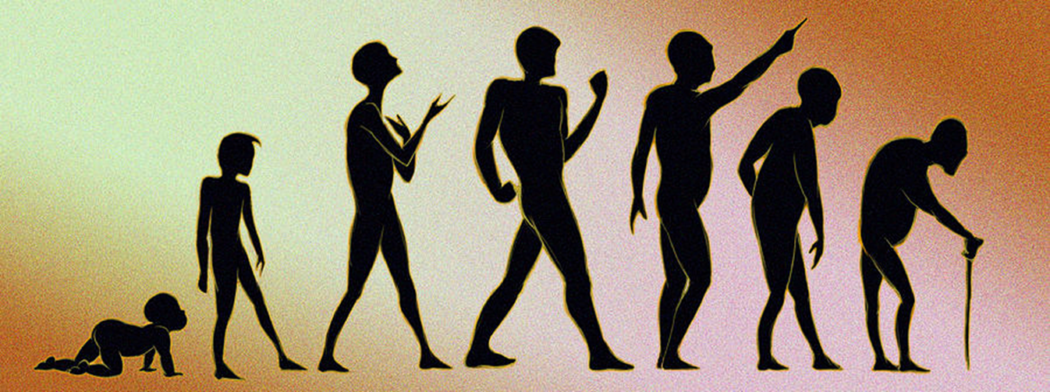
The seven ages?
“our history is still open . . . with a mission!”

Slide 4
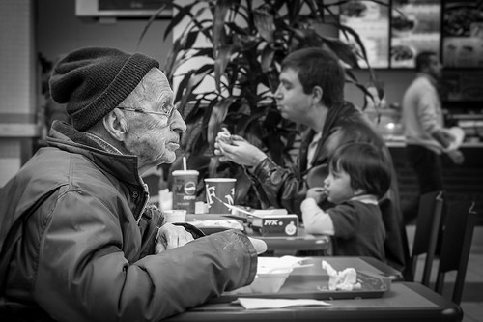
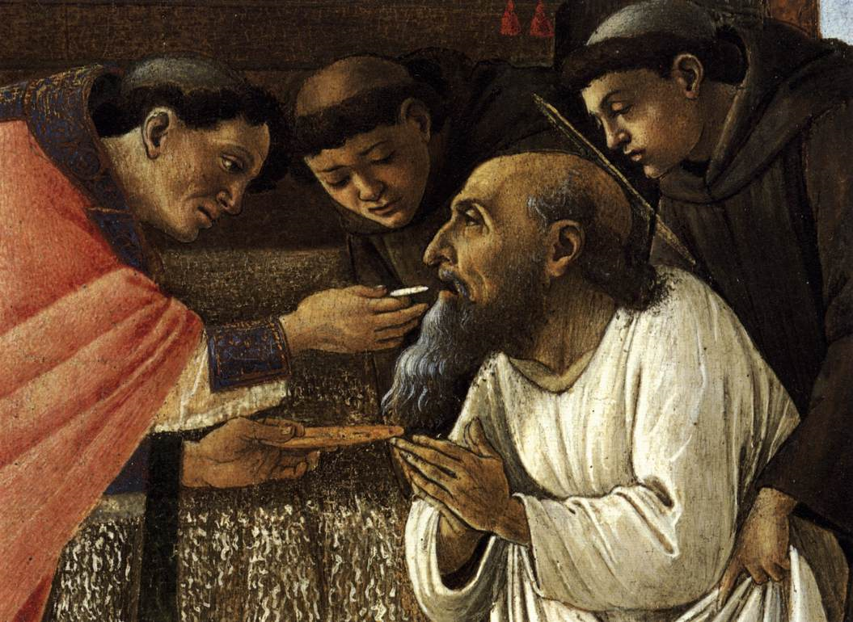
A “disease to keep away from . . .”
. . . or an icon of our shared frailty?
Notes:
Botticelli – Last communion of St Jerome

Slide 5

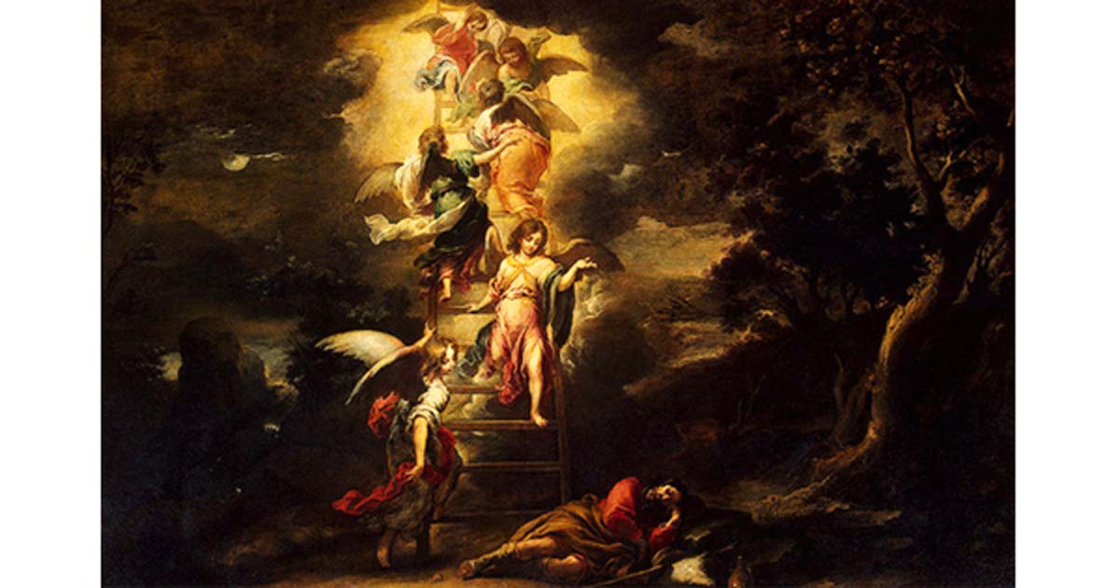
False fantasies . . .
. . . and true dreams

Slide 6
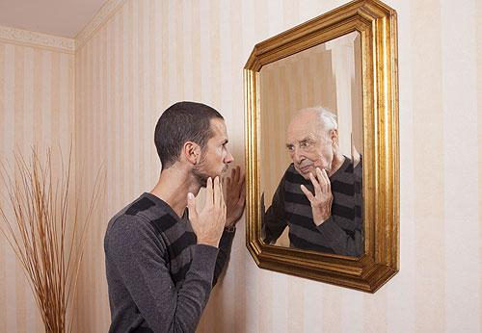
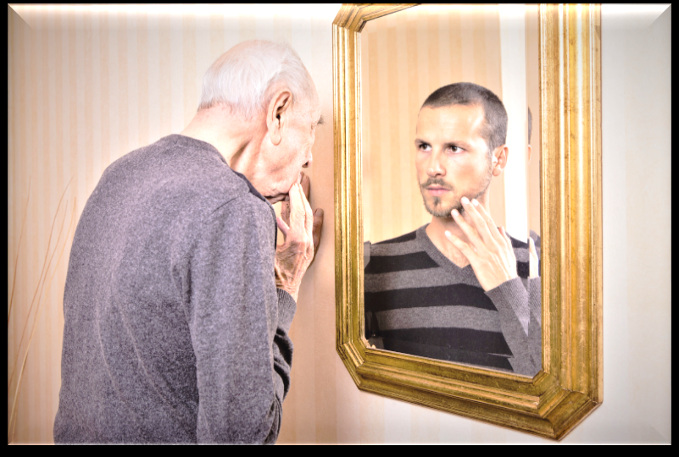
Reflection: inventing it for ourselves

Slide 7
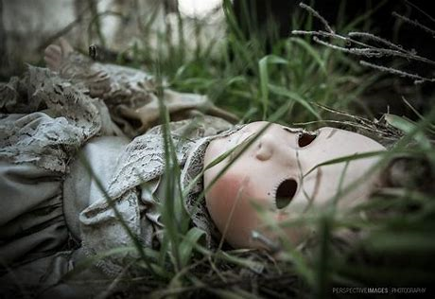
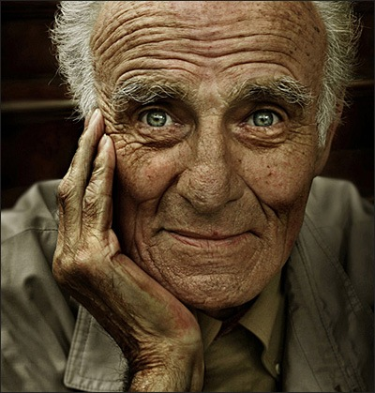
A blind, brutal ‘throwaway society’ . . .
. . . needs a new vision
of the gift of old age

